Slide 1
Project O.R.C.A
Luke Waller

Slide 2
Inspiration for the project
Standing bodies of water are continually getting more polluted and this is all ending up in the ocean.
Pollution in the sea is increasing at a rate of 10 million tonnes each year.
Studies suggest by 2050 the amount plastic in the sea will outnumber by the number of fish.
Over 500 dead zones where marine life cannot live.

Slide 3
Initial Project Aims
Create a boat that can float on water
Use a mechanism to scoop/collect the litter
Create a control system for the craft that will allow it to be remotely operated

Slide 4
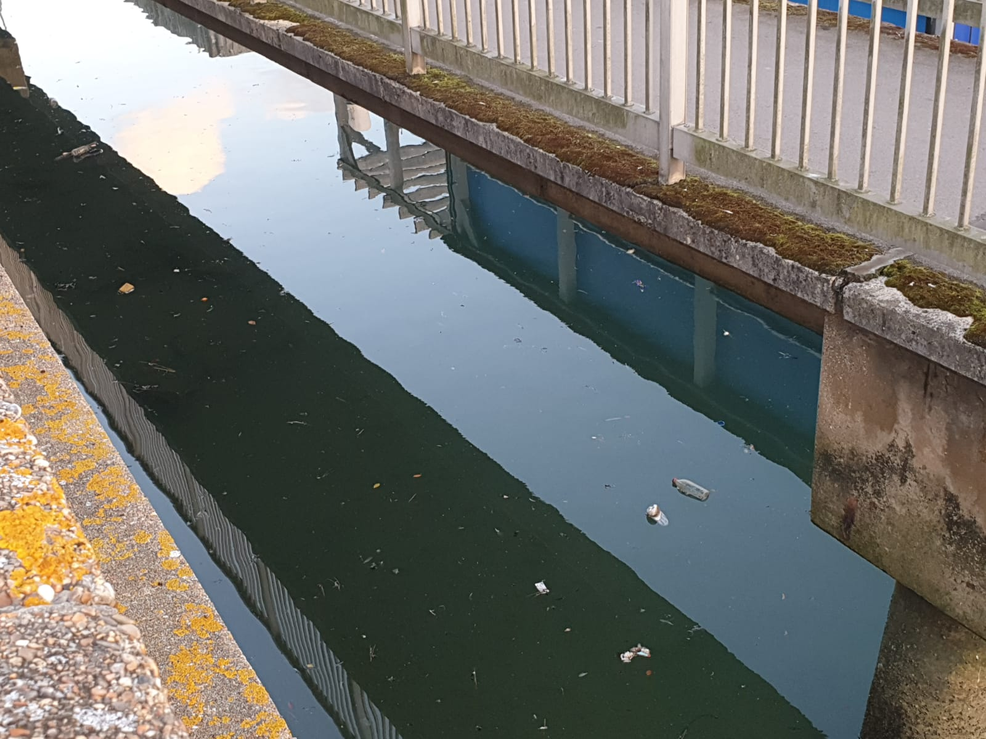
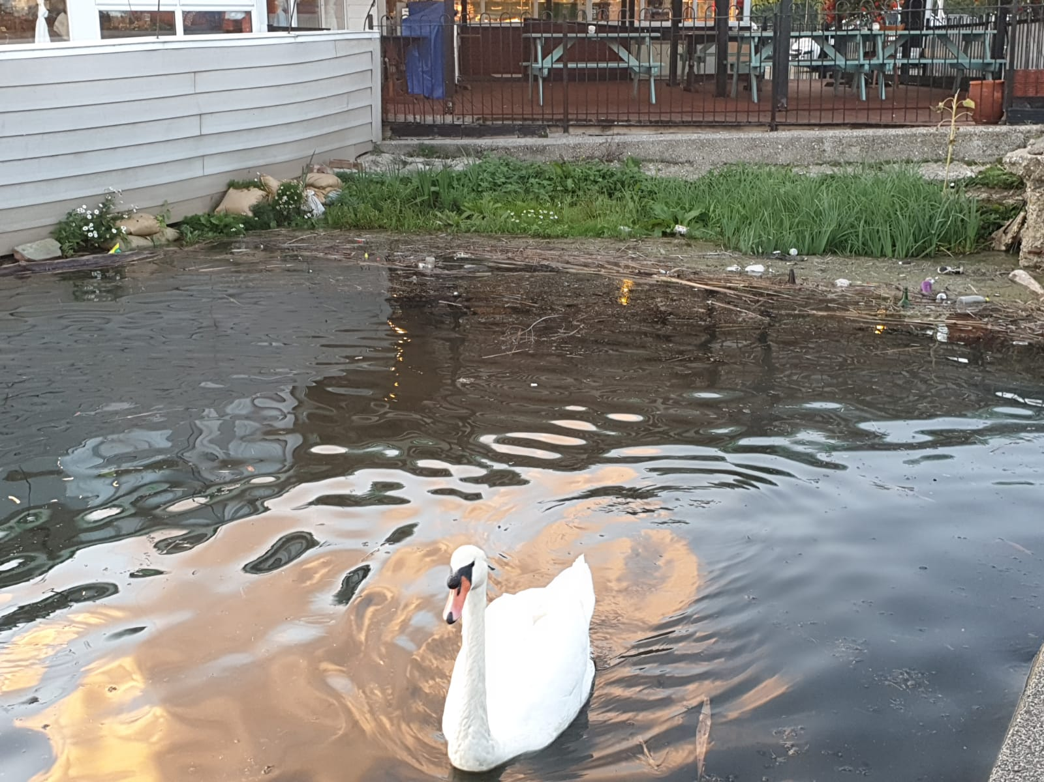
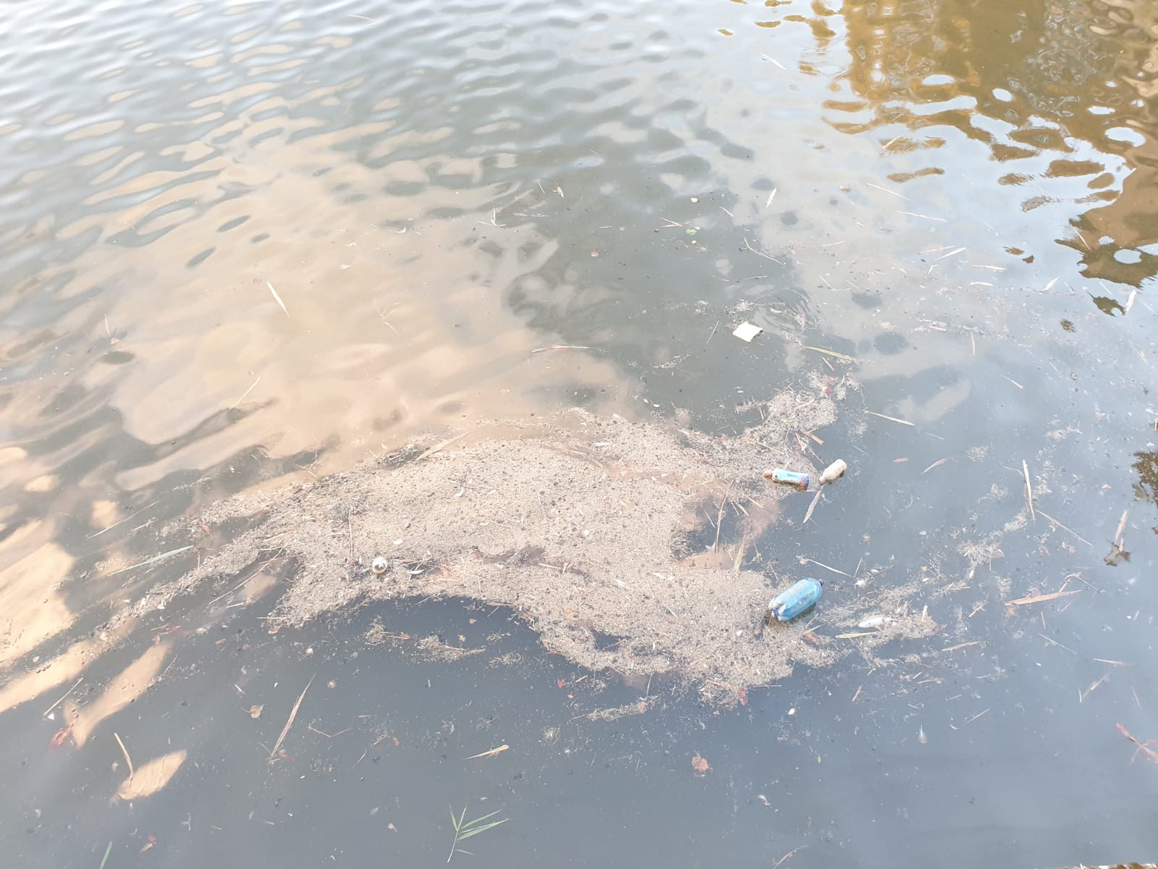
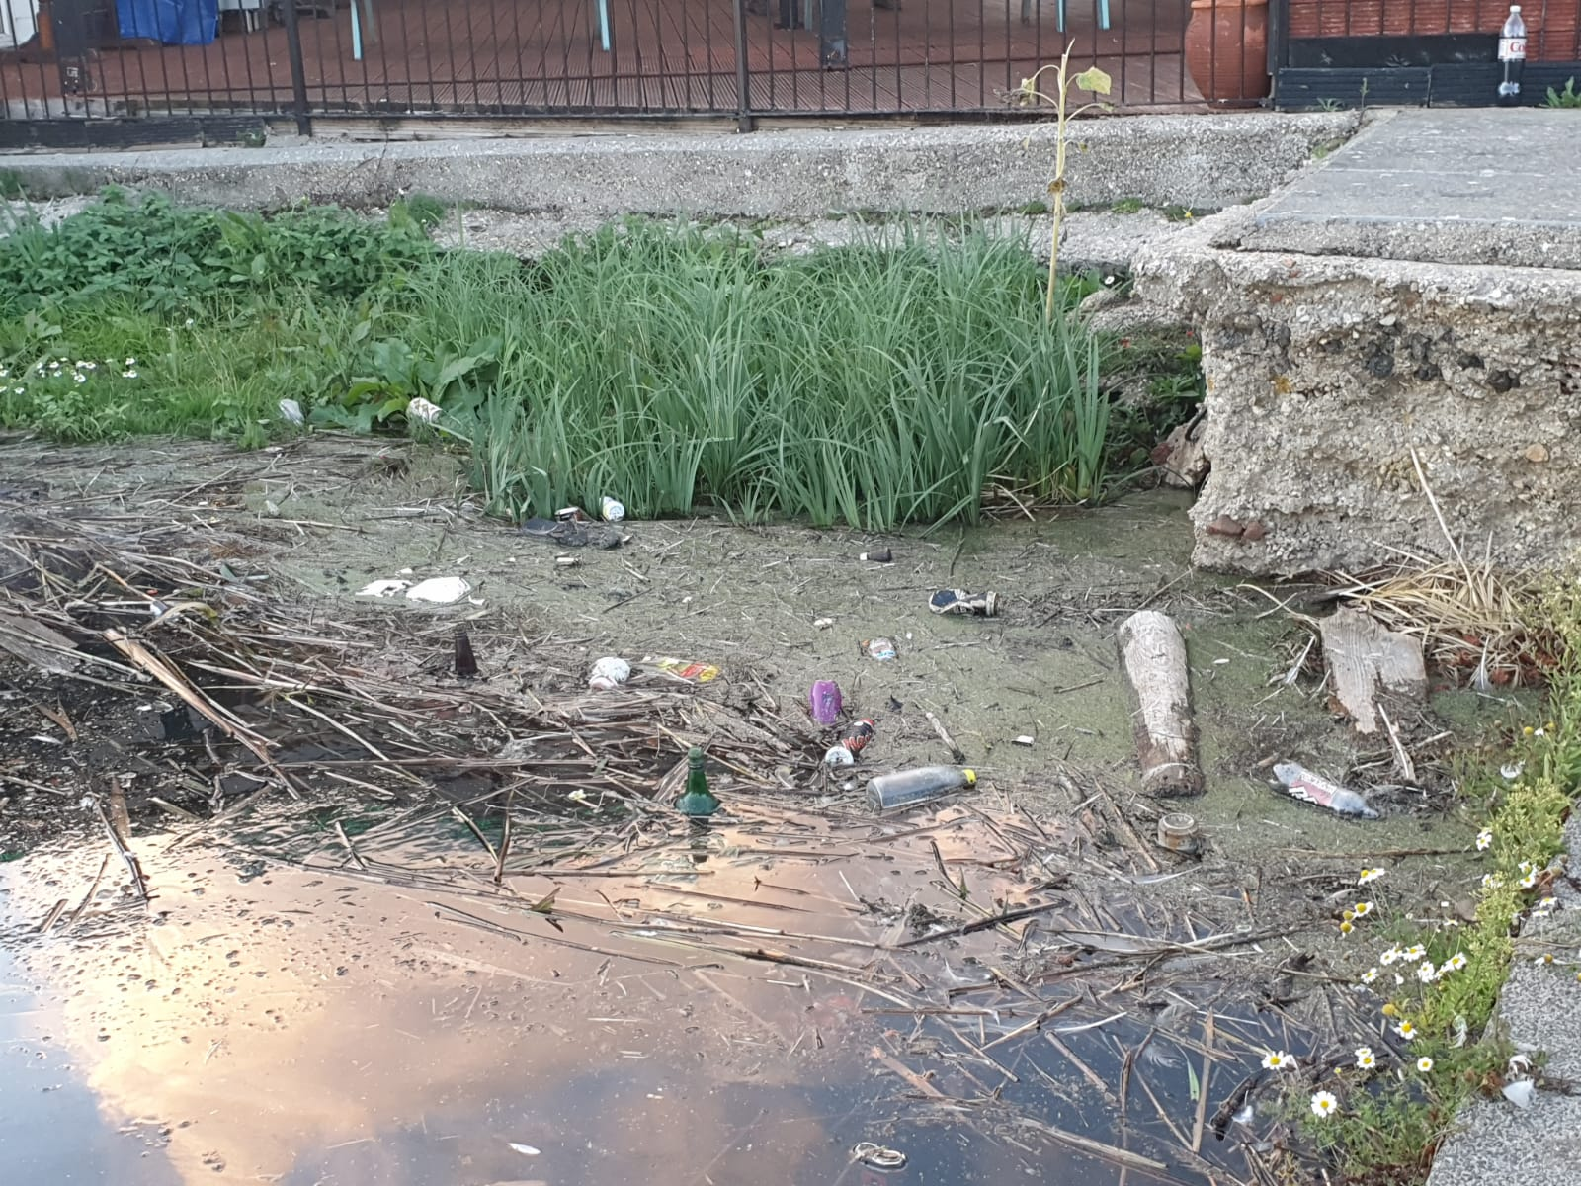
Local images of reservoir in Weymouth
This was one of the biggest inspirations for the project
Lived near this reservoir for over 20 years
Local wildlife lives among it

Slide 5
Project Goals

Slide 6
What were the issues that needed solving with software?

Slide 7
Who will benefit from this system and what savings will it offer?

